Slide 1
Zombie Killer

Slide 2
Zombie Killer
The project is a 2D runner-game, written with help of the Phaser framework. In this game you need kill zombies and pick coins. If u can reach a finish line u will win!

Slide 3
Game tutorial

Slide 4
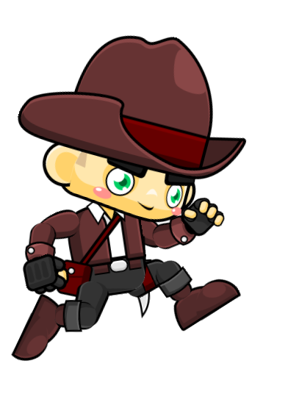
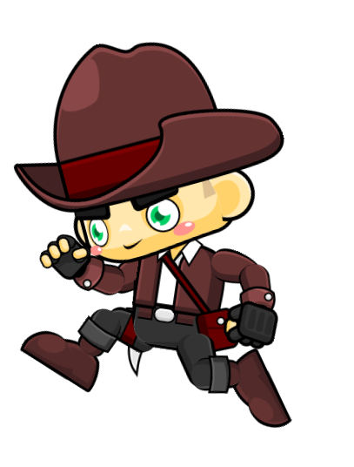

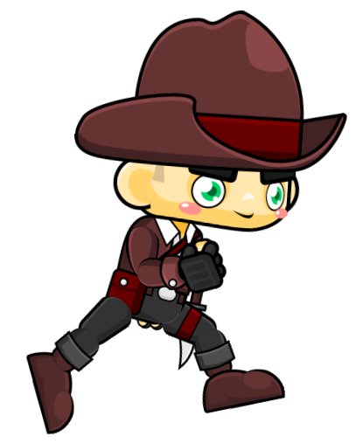
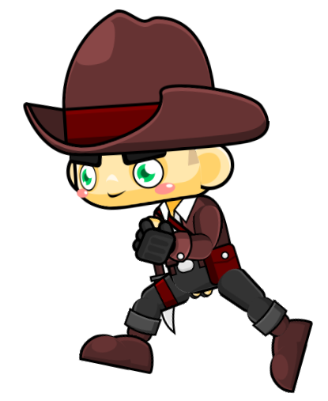
Use arrow keys for moving

Slide 5



Use spacebar for shooting

Slide 6
Let’s play a little?

Slide 7
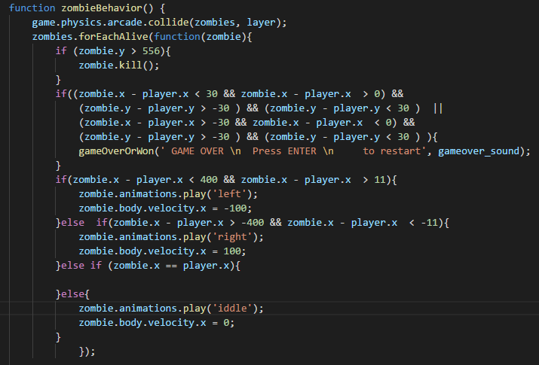
Zombies are following player code

Slide 8
Thanks for watching

